Slide 1
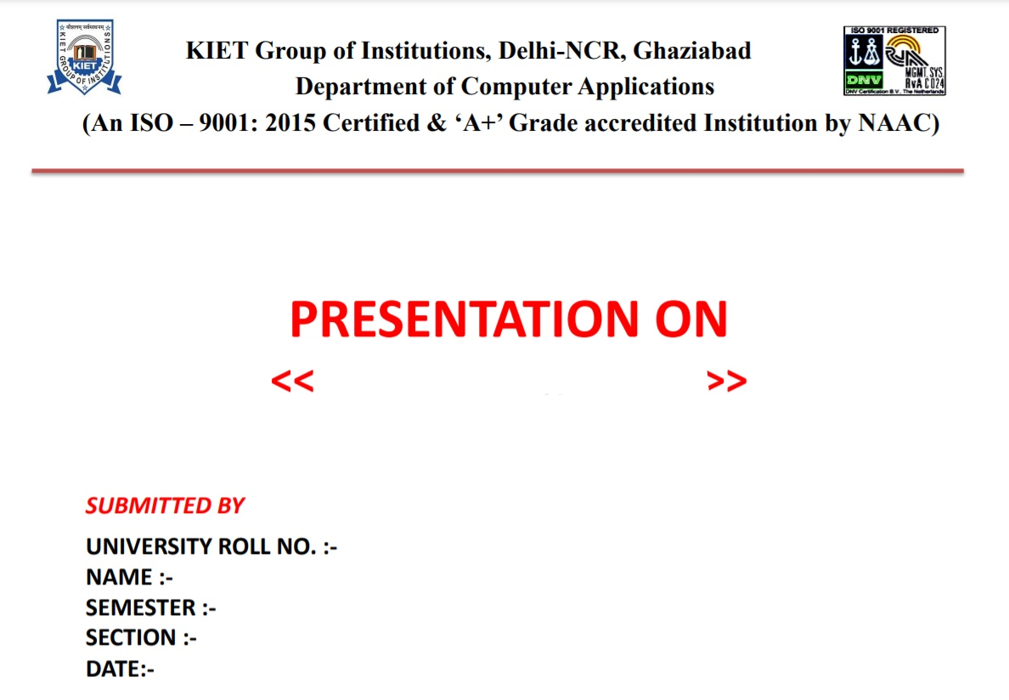
ANGULAR
1900290140015
Harshika Srivastava
6th
A
12/03/2022

Slide 2

Angular
Angular is a JavaScript framework which makes us able to create reactive Single Page Applications (SPAs).
This is a leading front-end development framework which is regularly updated by Angular team of Google

Slide 3

HISTORY
Angular was developed by Misko Hevery and Adam Abrons and is now maintained by GOOGLE.
It was first called as AngularJS.
Initial date of release is 14 September, 2016
Latest version of Angular is 13.1.1 released on 15 December 2021.

Slide 4
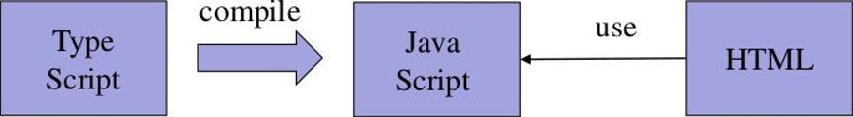
What is angular ?
It is a JavaScript Framework
It is used to build client-side applications using HTML
It bootstraps JavaScript with HTML Tags.
It is used to make reach UI application
It enhances UI experience for User
Angular code is written in TypeScript language
Typescript is compiled into JavaScript
JavaScript is used in HTML pages

Slide 5
1. Single page application is a web application or a website which provides users a very fluid, reactive and fast experience like a desktop application. 2. It contains menu, buttons and blocks on a single page and when a user clicks on any of them, it dynamically rewrites the current page rather than loading entire new pages from a server. 3. In a SPA, a page refresh never occurs; instead, all necessary HTML, JavaScript, and CSS code is either retrieved by the browser with a single page load.
What is Single Page Application (SPA)

Slide 6

Why Angular?
It is fast as most of the resources (HTML, CSS, JS) are only loaded once throughout the lifespan of application.
Data is loaded independently using REST APIS
Routing is handled in UI
Simplified and streamlined
More Control in UI – Less server involvement

Slide 7

Angular Enhances HTML
Angular has set of directives to display dynamic contents at HTML page.
It extends HTML node capabilities for a web application.
It provides data binding and dependency injection that reduces line of code.
It extends HTML attributes with directives, and binds data to HTML with Expressions.
It follows MVC Architecture.

Slide 8



MVC Architecture
Model:
Carry data between View and Controller.
View:
Contains display logics, developed using HTML and ANGULAR Directives.
Controller:
Contains navigation logic.
Decides data and view to be displayed

Slide 9
Install NODE
Node.js development environment can be setup in Windows, Mac, & Linux
Following development environment and editor are required to develop a node application:
Node.js
Node Package Manager (NPM)
IDE (Integrated Development Environment) or TextEditor.
Download installer and editor from
https://nodejs.org install node and npm
https://code.visualstudio.com : Visual Studio Code
We can check npm version by following command
npm -v

Slide 10
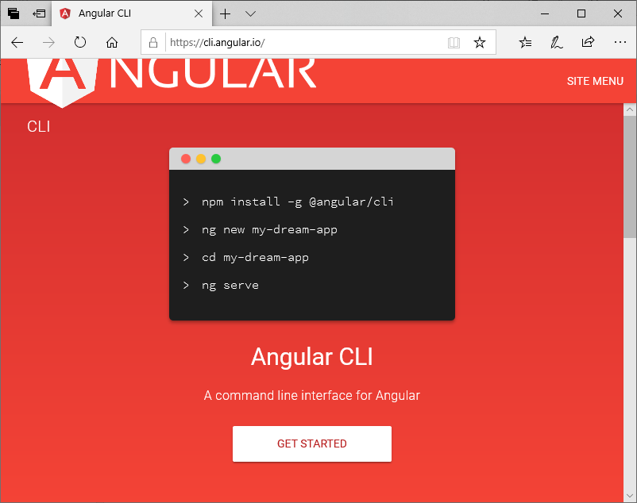
Install Angular cli We can run following command to install angular CLI. npm install @angular/cli –g After installation we can check version of angular by running following command: ng –version CLI stand for command line interface

Slide 11
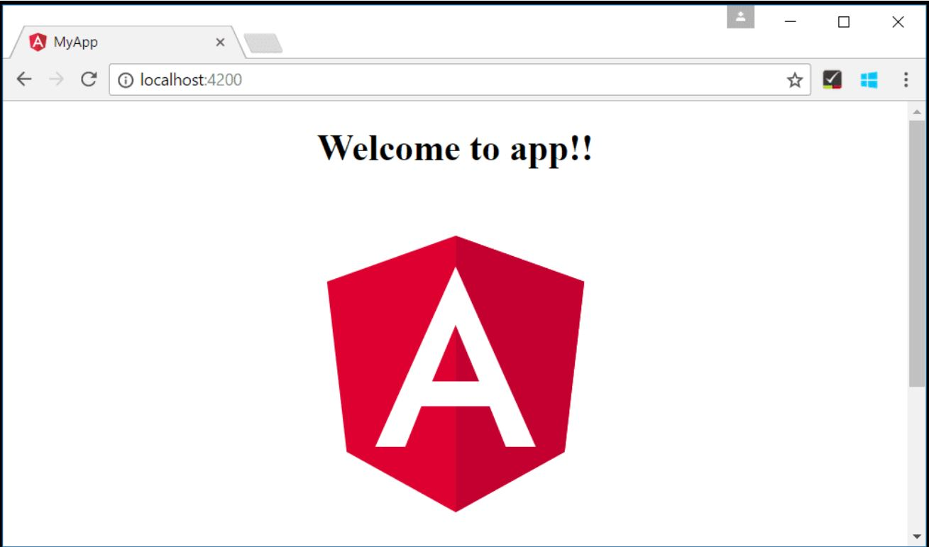
Create project Angular project is created using command: ng new project-name We are assuming project name is SOS ng new SOS above command will create project directory structure.
How to RUN the project
Run following command to run angular project
c:/SOS>ng serve -o
It will start angular server at default port number #4200
and make application accessible using https://localhost:4200

Slide 12

Data Binding
It is data synchronization between View and Controller.
Data Binding can be One-Way, where data change in controller is reflected at view, or Two-way, where data changes are reflected in both directives, controller and view.
The following types of bindings are supported by Angular:
One-way binding
Interpolation –{{attribute-name}}
Property Binding –[attribute-name]
Event Binding – (event)
Two-way binding –[(attribute-name)]

Slide 13
PIPE
Pipes are used to format the data.
It can be used to change data from one format to another. In Angular JS it is used to call filters.
Pipe (|) character is used to apply pipe to an attribute.
For example
{{ name | uppercase }}
{{ name | lowercase }}
Angular have following inbuilt pipe
Lowercasepipe
Uppercasepipe
Datepipe
Currencypipe
Percentpipe

Slide 14
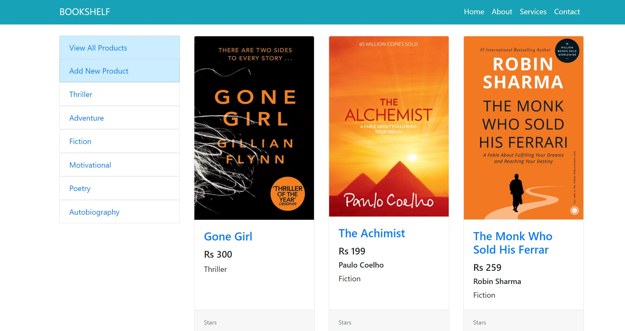
CRUD Application:

Slide 15
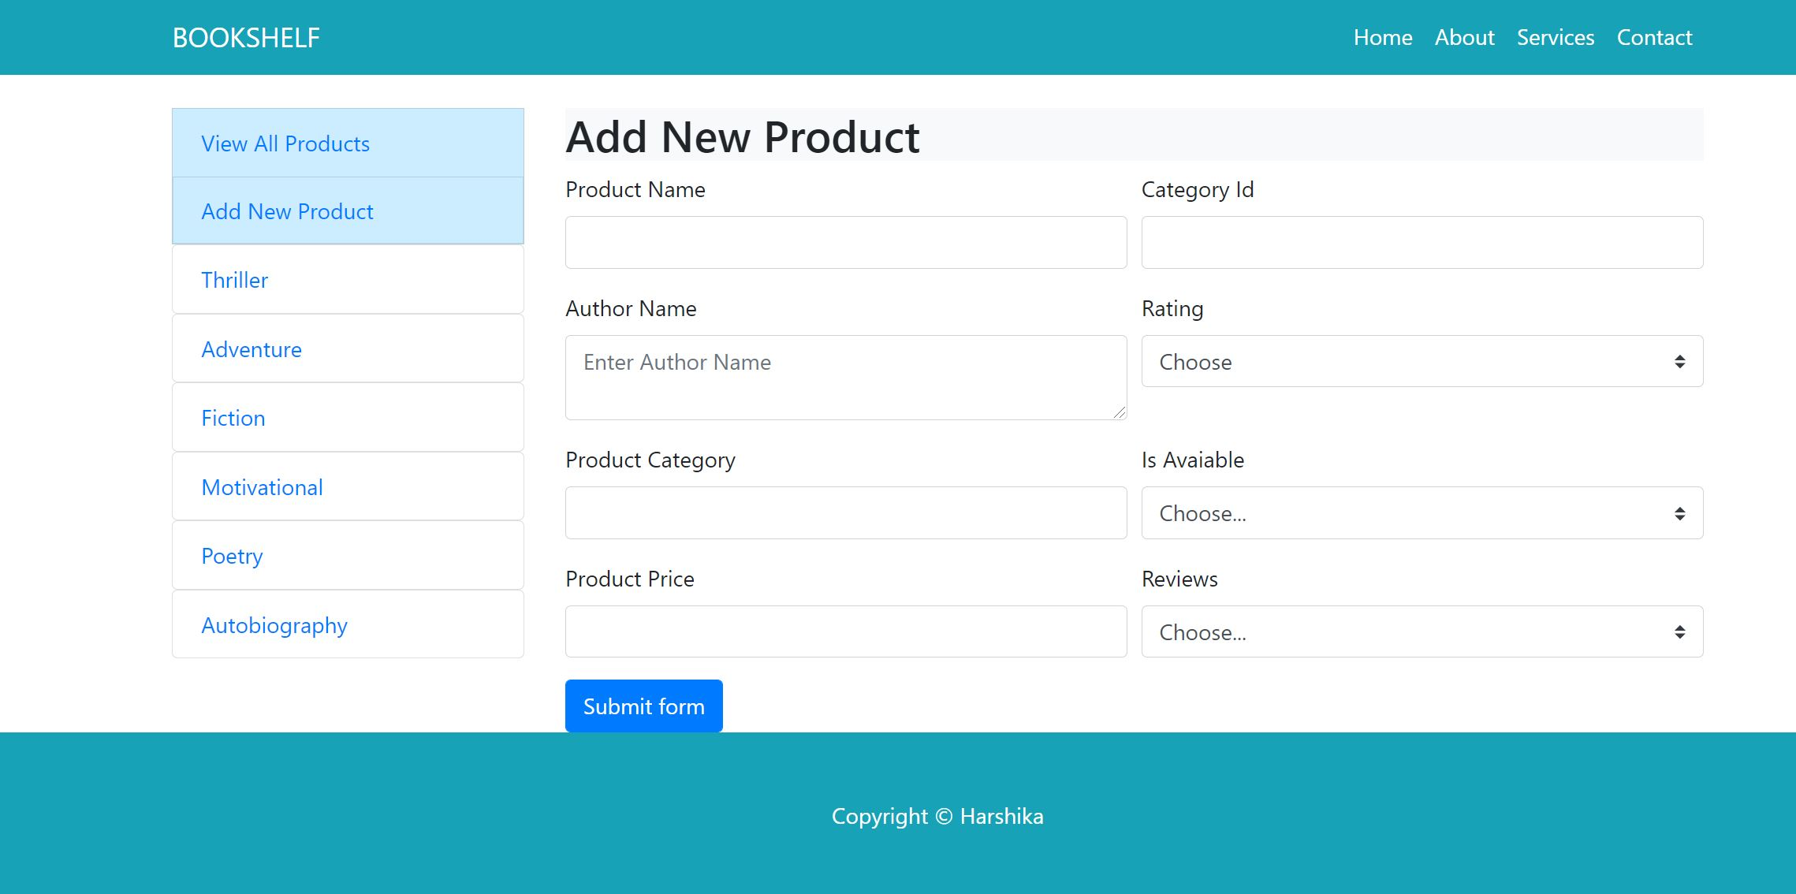
Example:

Slide 16
THANK YOU

